Slide 1


Pothole Detection System using AI & IoT
Presented By:
Anshul Gada (210303105579)
Juiee Yadav (210303130004)
Aman Jaiswal (210303105259)
Guided By:
Ankita Gandhi
Asst. Prof.
CSE Department
PIET, Parul University
Internal Project Presentation 2024

Slide 2
Content
Introduction
Background Study
Objectives of the Project
Project Team : Roles and Responsibilities
Time Line Chart - Schedule
UML Diagrams
Advantages of the System
Limitations of the System
Conclusion
Future Work
References
Internal Project Presentation 2024

Slide 3
Introduction
"Pothole Detection System using AI and IoT." In response to the escalating concern of road safety, our project employs cutting-edge technology by integrating Artificial Intelligence (AI) and Internet of Things (IoT) to detect potholes efficiently.
Using a drone as a capture device, our system analyzes images to identify and address the presence of potholes on roads. Also, we can gather images from various other sources, including dashcams and user submissions,
This solution not only aims to enhance road safety by providing early detection but also showcases the potential for a proactive and technologically advanced approach to infrastructure maintenance.
Join us as we unfold the details of this intelligent system and its role in revolutionizing the way we address the challenges posed by potholes on our roads.
Internal Project Presentation 2024

Slide 4
Background Study
Sr. No | Paper Title | Publisher | Year | Take - away points
1 | Detection and Segmentation of Cement Concrete Pavement Pothole Based on Image Processing Technology | College of Energy and Transportation Engineering, Inner Mongolia Agricultural University. | 2020 | Using multiple methods simultaneously to determine potholes rather one method at a time. Small pebbles and rocks show little to no influence on final results of detection of potholes. Otsu, Edge Detection, K-Means and Watershed methods are used by this AI Model.
2 | Applications of Artificial Intelligence Enhanced Drones in Distress Pavement, Pothole Detection, and Healthcare Monitoring with Service Delivery | Xi’an Aeronautical Institute, Xi’an, China. Northwestern Polytechnical University, Xi’an, China. | 2022 | Deep learning techniques like SVM, CNN, RNNs, BPNN are better at segmentation of images than existing edge methods like Sobel approach and Canny method. A huge amount of memory that is usually unavailable is essential to train CNN on high-resolution images.
Internal Project Presentation 2024

Slide 5
Sr. No | Paper Title | Publisher | Year | Take - away points
3 | Detection of Potholes on Roads using a Drone | Associate Professor, Dept of CSE, BMS Institute of Technology and Management, Bangalore, India. Dept of CSE, BMS Institute of Technology and Management, Bangalore, India. | 2021 | Using the YOLOv3 Model (state-of-the-art, real-time object detection system) and train it to identify potholes. The system accurately detects potholes on a road through imaging and creates an opensource map-based database of potholes on the road that is updated in real time. It also provides real time pothole information to the government and general public through the opensource map which enable the government to maintain and fix potholes faster. The system developed has an accuracy of 85% and also has a low rate of false-positives and false negatives.
4 | Detection of Pothole by Image Processing Using Unmanned Aerial Vehicles (UAVs) | Department of Electronics & Tele communication, Pimpri Chinchwad College of Engineering Pune, India. | 2020 | Proposed a method for automatic detection of potholes based on RGB color space image segmentation. Potholes are detected by filtering pixels using medium filters and morphological operations in MATLAB. After all linear and image boundary shapes are filtered, the remaining portions are detected as potholes. Passing the image through 5 steps to process and detect the potholes.
Internal Project Presentation 2024

Slide 6
Sr. No | Paper Title | Publisher | Year | Take - away points
5 | Detecting potholes using simple image processing techniques and real-world footage | Computer Science Division, Stellenbosch University, Private Bag X1, Matieland, South Africa. Department of E&E Engineering, Stellenbosch University, Private Bag X1, Matieland, South Africa. | 2015 | Without requiring any model training, the research proposed a solid preliminary approach for pothole recognition utilizing a single optical camera that can identify potholes within a range of ≈ 2 m to 20 m. The algorithm execution speed is sufficient for vehicles traveling at less than 60 km/h, according to time measurements of the algorithms; however, the real maximum distance at which a pothole may be identified has to be increased to take the driver's response time into consideration.
Internal Project Presentation 2024

Slide 7
Sr. No | Paper Title | Publisher | Year | Take - away points
6 | Use of drone based IoT system for road pothole detection and Volume calculation | Prof. Dr. Sc. Comp. Jansone A Kuduma K. , Assist. Prof. Dr. Biol Jurmalietis R. Faculty of Science and Engineering, Liepaja University, Latvia. | 2019 | This method is based on electromagnetic impulses radiation in tested media, and geo radar is device which performs digital treatment of emitted and reflected signals. Reason why response signal has been detected is the following: non-homogeneity within the tested object like split or density change. Development of Object identification and volume calculation algorithm.
7 | Terrain surveillance system with drone and applied machine vision | Department of Applied Computing Sciences, Madras Scientific Research Foundation, Chennai, Tamil Nadu, India. | 2019 | Network topologies such SSD Mobilenet, CNN, Faster RCNN, and Mask RCNN were used to train it. Using imaging, the system precisely locates potholes on a road and generates a real-time, open-source map-based database of potholes. At a speed of 443 ms, the model produced pixel masks and identified pictures with 81% accuracy. The algorithm was then combined with the drone camera and the Google Maps API via the DB2 database to create a superior navigational assistance system that provides comprehensive information about the selected routes. The development of this classifier is to support data collection for more effective road maintenance and help reduce the number of road accidents.
Internal Project Presentation 2024

Slide 8
Sr. No | Paper Title | Publisher | Year | Take - away points
8 | IoT based detection of bore-well unclosed holes using automated drone operated cameras in a remote area | Department Of Information Technology, Bannari Amman Institute of Technology, Sathyamangalam, India. | 2021 | This System is tested with different inputs and parameters are tested with various locations and measured the distance of borewells using ultrasonic sensors. The threshold value of the distance using an ultrasonic sensor. This depth sensing system can be used to analyze the depth of a pothole along with its detection so we can identify the level of danger it possesses to a driver.
9 | Object Detection using IoT and Machine Learning to Avoid Accident and Improve Road Safety | Department of Computer Engineering, Dr. D.Y Patil School of Engineering Lohegaon, Pune, India. Savitribai Phule, Pune University, Pune, India | 2020 | Developed an effective system for a real-time environment that detects the presence of obstacles on the vehicle track. The main goal of this project is to develop object detection for accident avoidance and improving the Road Safety with Use of Raspberry Pi The result analysis shows that proposed system is more precise and consumes less time than existing CNN and YOLO object detection methods.
Internal Project Presentation 2024

Slide 9
Sr. No | Paper Title | Publisher | Year | Take - away points
10 | An Automated Machine Learning Approach for Road Pothole Detection Using Smartphone Sensor Data | School of Public Affairs, Zhejiang University, Hangzhou, China. | 2020 | Simple detection algorithms achieved 90% success in speed breaker detection, 85% in pothole detection. Method's performance evaluated across datasets from different road types. Limitations include undisclosed false positive rate and neglect of road type in detection. Concludes method is effective for pothole detection via smartphone sensor data, with potential for safety enhancement and cost reduction.
11 | Pothole Detection Using Deep Learning: A Real-Time and AI-on-the-Edge Perspective | Swarm Robotics Lab, National Centre of Robotics and Automation, Rawalpindi, Pakistan. | 2022 | Three models (Tiny-YOLOv4, YOLOv4, YOLOv5) compared for performance. Experimentation conducted on diverse image dataset and real-time video from moving vehicle. Results show Tiny-YOLOv4, YOLOv4, and YOLOv5 achieving high mean average precision (mAP) of 80.04%, 85.48%, and 95% respectively. Tiny-YOLOv4 identified as best model for real-time detection with 90% accuracy and 31.76 FPS on OAK-D.
Internal Project Presentation 2024

Slide 10
Sr. No | Paper Title | Publisher | Year | Take - away points
13 | Real-time machine learning-based approach for pothole detection | Centre of Excellence in Mobile and Emerging Technologies (CEMET), Faculty of Computing, Engineering and Science, University of South Wales, Pontypridd, UK. | 2021 | Data collected from multiple Android devices/cars. Pre-processing and training of binary classifier using statistical features. Methodology involves data collection, labeling using bespoke Android apps, and preprocessing of raw sensor data. Data collection covers five routes, road surfaces, and four cars.
14 | Review of Recent Automated Pothole Detection Methods | C4ISR Systems Development Quality Team, Defense Agency for Technology and Quality, Korea. | 2022 | Vision-based method utilizes images or videos for detection. Vibration-based method relies on data from vehicle sensors. 3D reconstruction-based method employs stereo-vision technology.
Internal Project Presentation 2024

Slide 11
Sr. No | Paper Title | Publisher | Year | Take - away points
15 | Smart Pothole Detection Using Deep Learning Based on Dilated Convolution | School of Computing, Southern Illinois University, Carbondale, United States. | 2021 | Modified VGG16 network and custom loss function utilized. System compared with Faster R-CNN and YOLOv5. Performance evaluated using precision, recall, accuracy, and mean average precision (mAP). Achieves high accuracy and mAP values, demonstrating effectiveness.
Internal Project Presentation 2024

Slide 12
Sr. No | Paper Title | Publisher | Year | Take - away points
16 | Multi-lane Pothole Detection from Crowdsourced Under sampled vehicle Sensor Data | Dept of Electrical and Computer Engineering, Carnegie Mellon University, Pittsburgh, USA. General Motors Corporation. | 2017 | Here, the issued raised on how noisy and under sampled accelerometer data from embedded vehicles sensors could be crowdsourced to detect and localize potholes in multi-lane environments. It demonstrated how road angle data can be calculated with individual accelerometer measurements on vehicles and how that information can be used to isolate acceleration components related to potholes and to filter the amount of data transmitted to cloud.
17 | An Automated Machine-Learning Approach for Road Pothole Detection Using Smartphone Sensor Data | University of Cambridge, Trumpington Street, Cambridge, UK. Imperial College London, London, UK. Zhejiang University, Hangzhou, China. Université Laval, Quebec City, Canada. Zhejiang University, Haining, China. | 2020 | Objective is developing a method for using smartphones with embedded accelerometers to identify potholes in road surfaces, which would significantly reduce the time and resources required for pothole detection. The feasibility of this idea was confirmed, as machine-learning models with features extracted from acceleration signals along three axes achieved significant precision and recall for pothole classification.
Internal Project Presentation 2024

Slide 13
Sr. No | Paper Title | Publisher | Year | Take - away points
18 | A Real Time Pothole Detection Based on Deep Learning Approach | Faculty of Engineering, Universiti Teknologi Malaysia, Johor Bahru, Johor, Malaysia | 2020 | Pothole detection using YOLOv3 (You Only Look Once, version 3) deep learning algorithm has been studied and proven successful with its 65.65 map, 0.9 % precision rate and 0.45 % recall rate. This setup can be installed in public transport with higher coverage and frequency of travelling. Which would help to detect the pothole and reduce the accidents due to pothole problem with high efficiency and accuracy system.
19 | A Modern Pothole Detection technique using Deep Learning | Department of Ele. & Electronics Engineering, Gaya College of Engineering Gaya, Bihar, India. Department of Computer Science and Engineering National Institute of Technology, Prayagraj, UP, India. | 2020 | Proposed a system to detect potholes in real-time in images/videos captured by a camera mounted on the vehicle and to give an alert to the driver about the pothole on road in front of the vehicle. The future work is Further, system will detect the location of the pothole and upload the same on map (reflected in android app developed by us) .so that other users who have no camera mounted on their vehicle can get alert about the pothole using the App.
Internal Project Presentation 2024

Slide 14
Sr. No | Paper Title | Publisher | Year | Take - away points
20 | Metrology and Visualization of Potholes using the Microsoft Kinect Sensor | National University of Sciences and Technology, Islamabad, Pakistan. School of Architecture, Design and the Built Environment, Nottingham Trent University, Burton Street, Nottingham, UK. | 2014 | Used the Kinect sensor shows a promising future for pavement visualization and metrological analysis of potholes. Different parametric calculations (volume, depth, Eccentricity) can be easily and efficiently done on the images acquired by this sensor. It gives us more detailed data of pavement distress as compared to simple vision technique. This method is better than the stereo vision as depth measured by IR camera is readily available. It is also cheaper as compared to lasers.
Internal Project Presentation 2024

Slide 15
Objectives
What exactly is to be done?
Develop an advanced Pothole Detection System using AI and IoT.
Utilize a drone as the primary image capture device for comprehensive road coverage.
Train an AI model to accurately detect and identify potholes in captured images.
Why is this project selected?
Address the escalating concern of road safety due to potholes.
Introduce a proactive and efficient solution for early pothole detection.
Embrace technological innovation to revolutionize traditional road maintenance methods.
3. Where is the project helpful?
Applicable in urban and rural areas with varying road conditions.
Beneficial for municipal corporations, transportation agencies, and local authorities responsible for road maintenance.
Enhances road safety by identifying potholes in a timely manner.
Internal Project Presentation 2024

Slide 16
Objectives
4. When can it be implemented?
Implementation can begin as soon as the system development is complete.
The modular nature of the system allows for gradual deployment and integration into existing infrastructure.
5. Who will benefit?
Municipalities and city authorities responsible for road maintenance.
Drivers and commuters who will experience safer roads and reduced accidents.
Transportation agencies seeking an efficient and technology-driven approach to road safety.
Internal Project Presentation 2024

Slide 17
Project Team: Roles and Responsibilities
Sr. No | Team Member | Enrollment Number | Role | Responsibility
1 | Anshul Gada | 210303105579 | Project Manager | Oversee and contribute to all aspects of the project’s development and implementation.
2 | Juiee Yadav | 210303130004 | AI Model Developer | Develop and train the AI model for pothole detection. Optimize and fine-tune the model for accuracy and efficiency. Collaborate with the Image Processing team for seamless integration. Develop and maintain software components for reliable data communication and connectivity.
3 | Aman Jaiswal | 210303105259 | Software Developer (IoT Integration) | Implement and manage the integration of the IoT module within the Pothole Detection System, ensuring compatibility with the chosen IoT architecture. Oversee seamless hardware and software integration on the drone platform. Implement mechanisms for image capturing and storage, and collaborate with the AI Model Developer to support real-time image processing.
Internal Project Presentation 2024

Slide 18
Time Line Chart - Schedule
 | January | February | March | April | May | June | July | August | September | November
Research & Project Planning
Role Assignment
Design & Prototyping
Documentation
Model Development
Hardware Setup
Software Implementation
Testing & Quality Assurance
Deployment
Internal Project Presentation 2024

Slide 19
UML Diagrams
Unified Modeling Language (UML) is a standardized modeling language in software engineering, facilitating visual representations of a system's design and behavior. The following diagrams are commonly used:
Class Diagram:
Illustrates the static structure of a system, showing classes, attributes, methods, and relationships.
Use Case Diagram:
Visualizes system functionality from the end user's perspective, highlighting use cases and actors.
Sequence Diagram:
Shows interactions between objects over time, portraying message flow during a specific scenario.
Activity Diagram:
Represents the flow of activities within a system, depicting actions, decisions, and concurrent activities.
Deployment Diagram:
Illustrates the physical deployment of software components and hardware nodes in a distributed system.
UML diagrams serve as powerful communication tools, aiding in design, documentation, and collaboration throughout the software development process.
Internal Project Presentation 2024

Slide 20
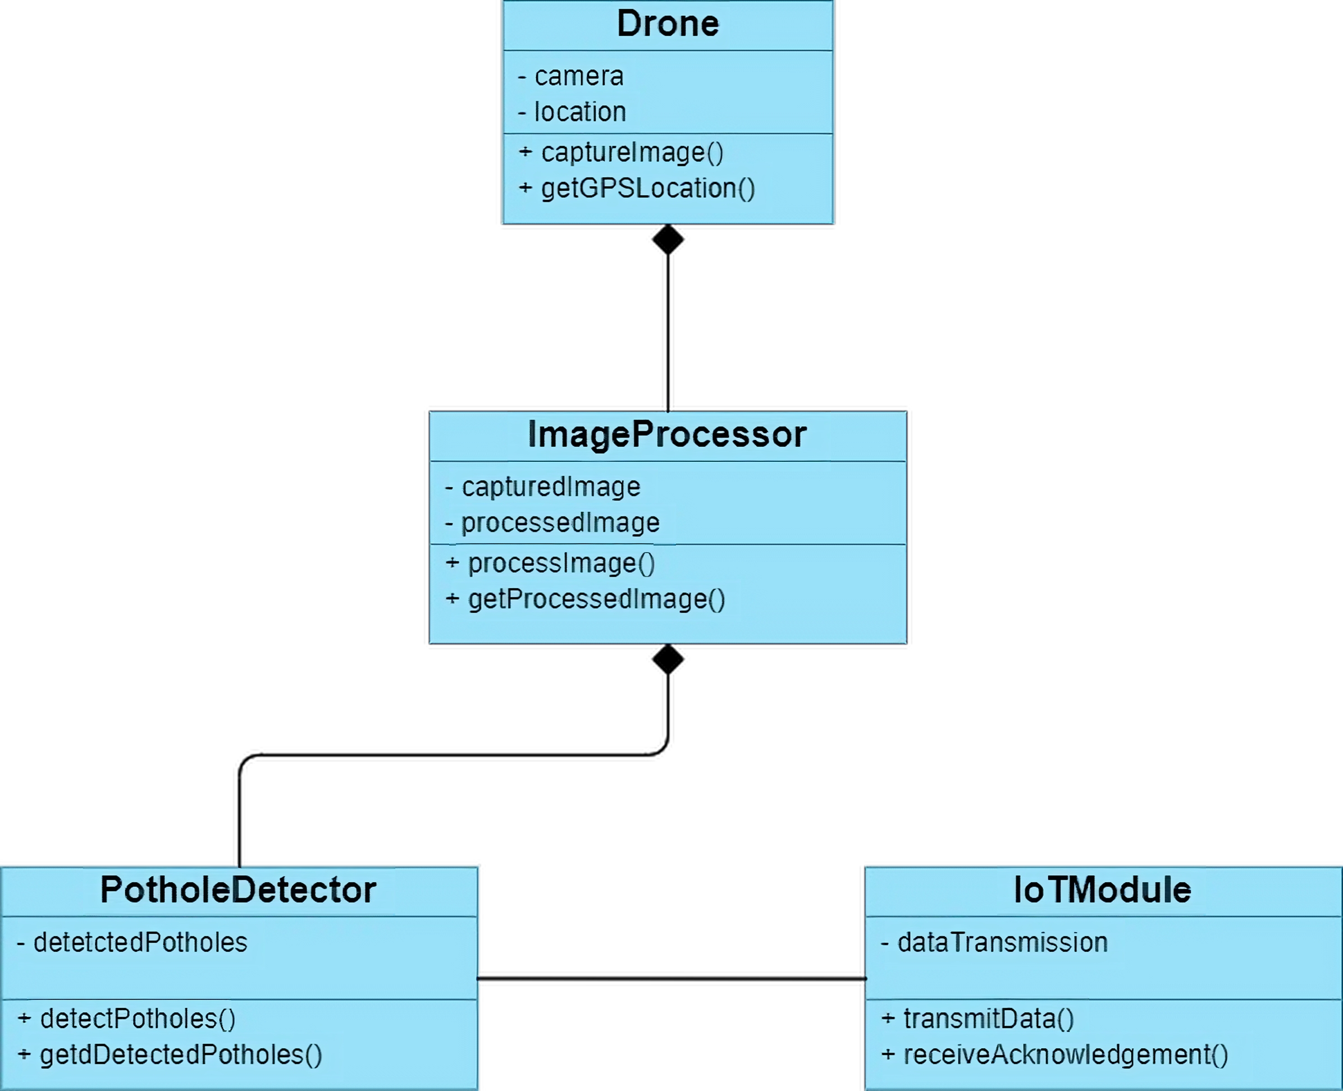
Class Diagram:
Internal Project Presentation 2024

Slide 21
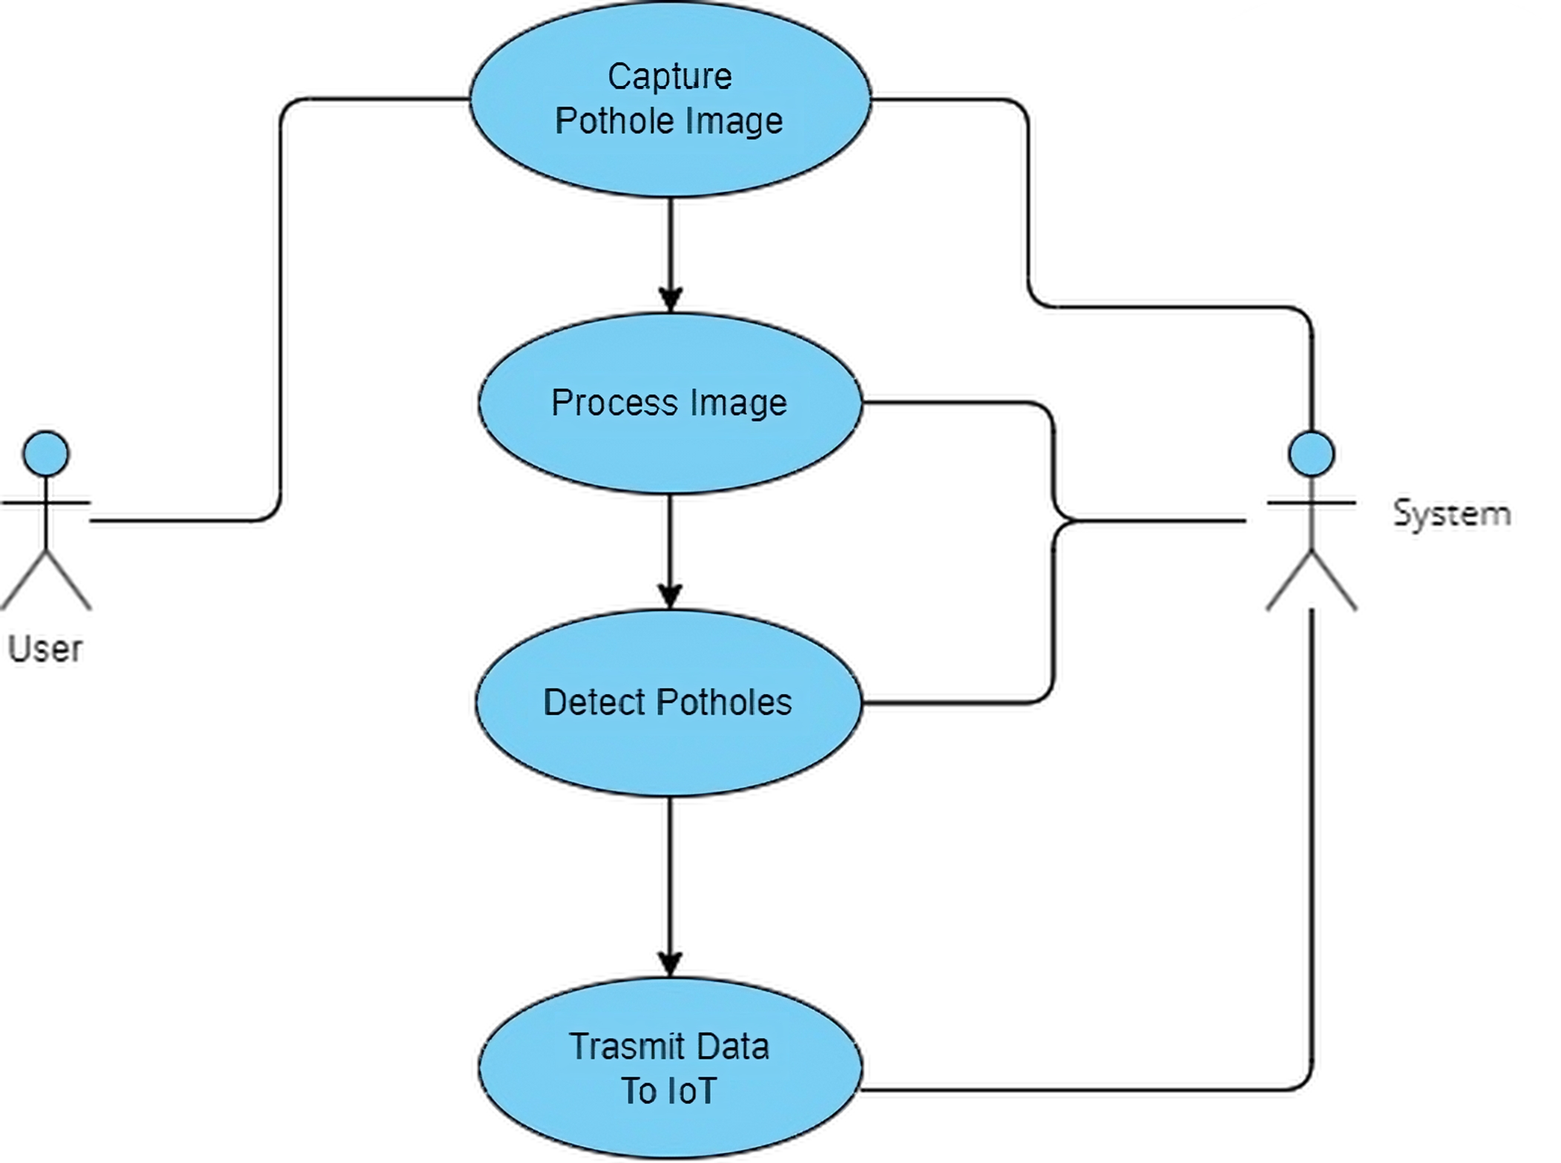
Use Case Diagram:
Internal Project Presentation 2024

Slide 22
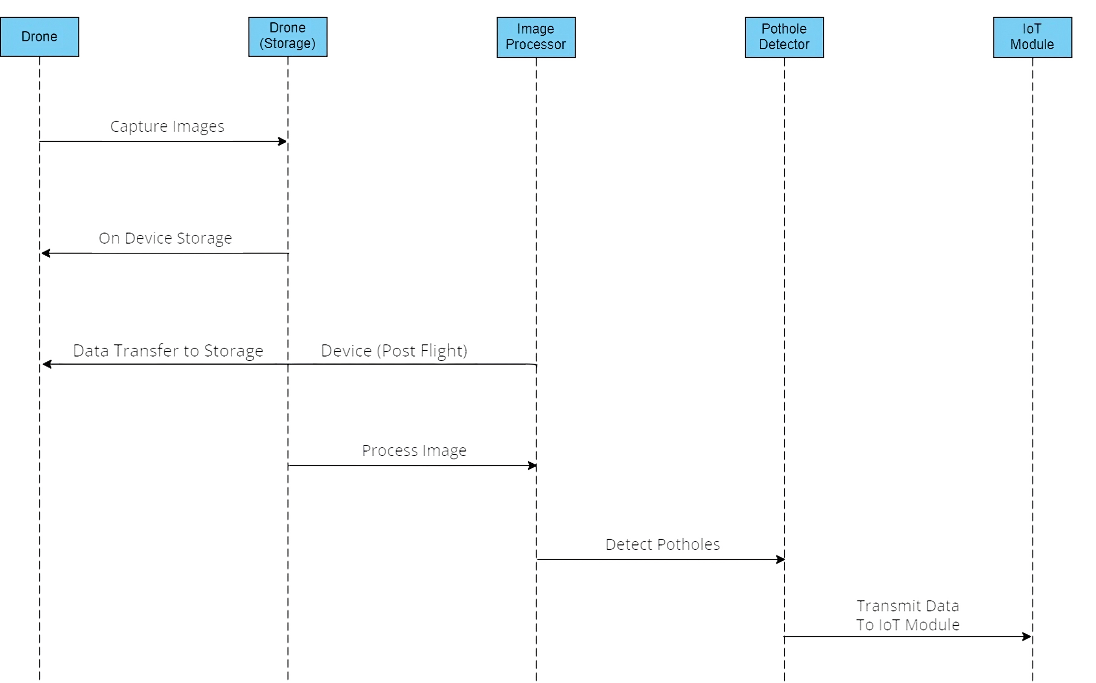
Sequence Diagram:
Internal Project Presentation 2024

Slide 23
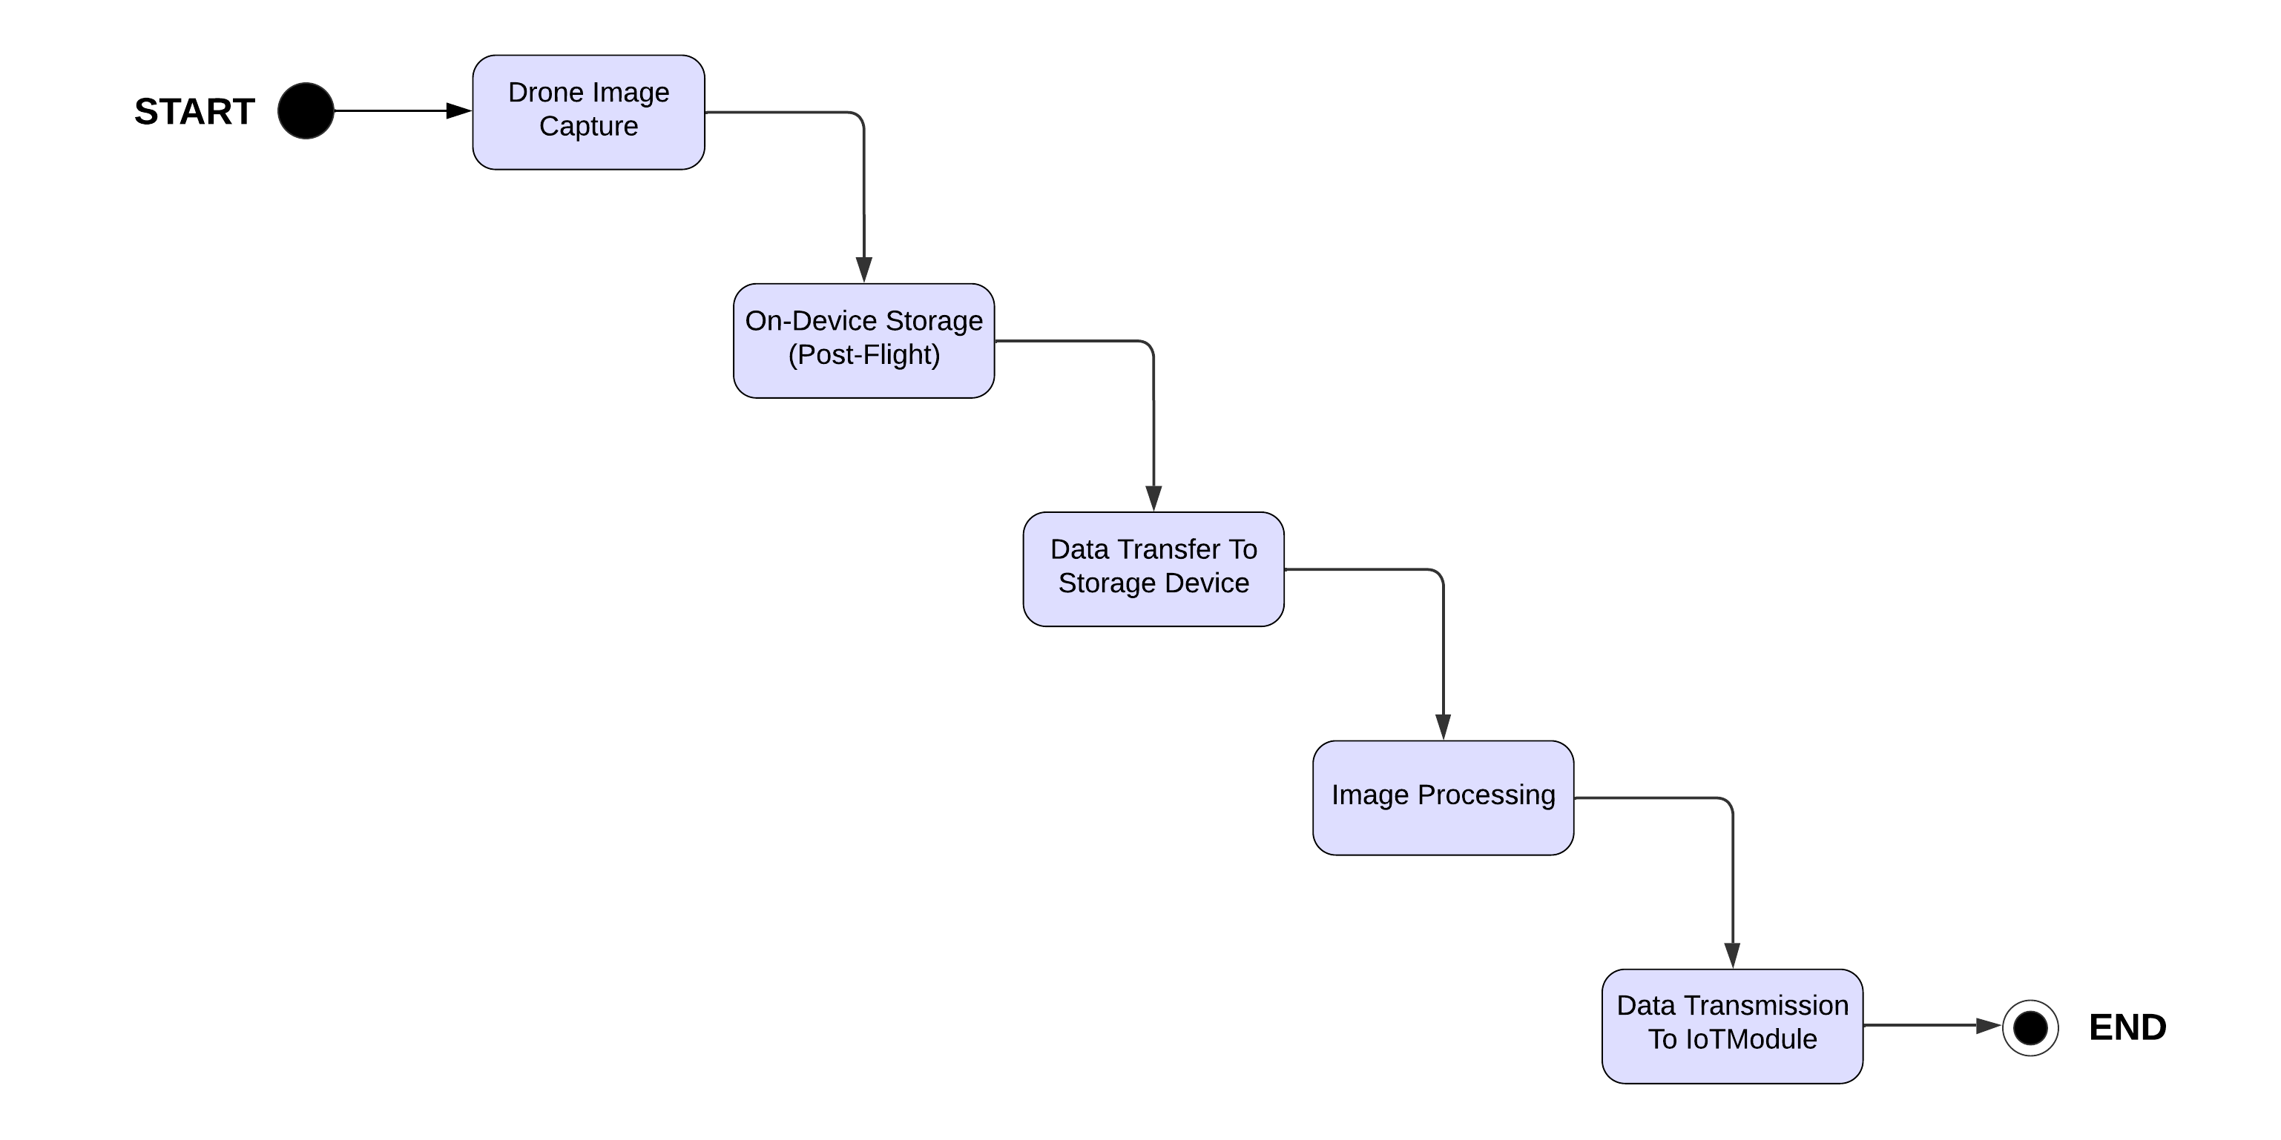
Activity Diagram:
Internal Project Presentation 2024

Slide 24
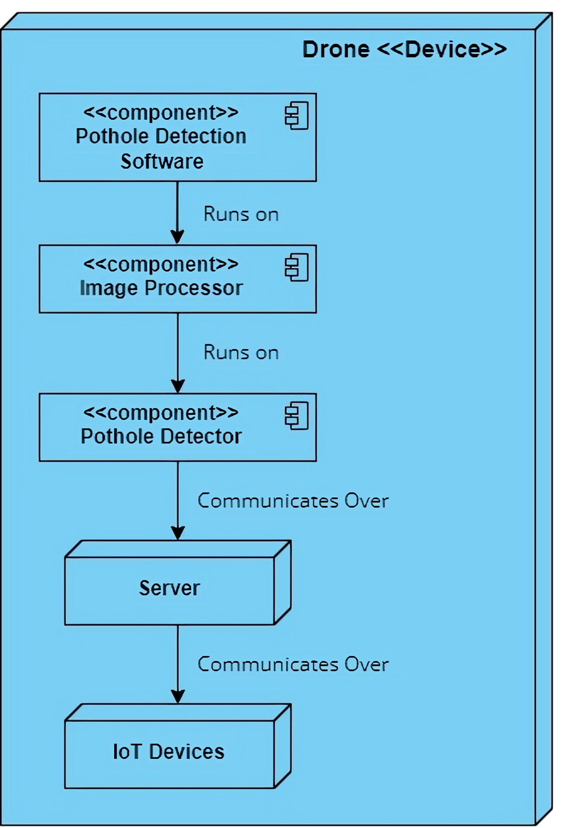
Deployment Diagram:
Internal Project Presentation 2024

Slide 25
Advantages of the System
In comparison to the prevailing methods of pothole detection and road maintenance in India, our Pothole Detection System using AI and IoT offers several key advantages.
Traditional approaches often rely on manual inspections, which can be time-consuming, labor-intensive, and prone to human error. Our system provides a more efficient and automated solution.
By utilizing a drone as the primary capture device, we can cover larger areas in less time, ensuring a more comprehensive and timely detection of potholes. This proactive approach not only accelerates the identification process but also allows for quicker intervention, addressing road safety concerns promptly.
Moreover, the integration of Artificial Intelligence enhances the accuracy of detection, reducing the dependency on subjective assessments. This technological advancement not only streamlines the detection process but also contributes to a more reliable and consistent approach to road maintenance. Ultimately, our system offers a comprehensive, technologically advanced, and cost-effective solution that aligns with the evolving needs of road maintenance in the Indian context.
Internal Project Presentation 2024

Slide 26
Limitations of the System
While our Pothole Detection System using AI and IoT presents a robust solution to road safety challenges, it is important to acknowledge certain limitations.
One potential constraint lies in the reliance on image data for pothole detection. Environmental conditions, such as poor lighting or adverse weather, may impact the system's performance. Additionally, the accuracy of the model could be influenced by variations in road surfaces and textures.
Furthermore, the deployment of drones may encounter regulatory and privacy considerations, requiring adherence to aviation laws and ensuring user consent for image submissions. As with any technology, there may be a learning curve for system users, and the effectiveness could be contingent upon consistent updates and refinements to the AI model.
Despite these challenges, we recognize the importance of addressing these limitations as part of our ongoing commitment to refining and optimizing the system for practical and widespread use in real-world scenarios.
Internal Project Presentation 2024

Slide 27
Conclusion
In conclusion, the "Pothole Detection System using AI and IoT" represents a significant stride towards addressing the pressing issue of road safety. By harnessing the power of Artificial Intelligence and the Internet of Things, our project introduces an intelligent and proactive solution for the timely detection of potholes.
The integration of a drone as the primary capture device showcases the potential for cutting-edge technology in revolutionizing infrastructure maintenance. The accuracy and efficiency achieved through our model underscore its practicality in enhancing road safety measures.
As we move forward, this project lays the foundation for a smarter, more responsive approach to road safety, contributing to the creation of safer and more sustainable transportation systems. We anticipate the ongoing development and potential expansion of this system, poised to make a lasting impact on our roads and communities.
Internal Project Presentation 2024

Slide 28
Future Work
Looking ahead, the future development of our Pothole Detection System involves a compelling expansion beyond the current capabilities. While our focus remains on utilizing drones as the primary capture device, an intriguing avenue for future work includes the incorporation of an additional capture device equipped with an ultra-sonic sensor.
This specialized sensor could be strategically mounted on a ground-based vehicle or another suitable platform. The enhanced system would continue to capture high-resolution images for accurate pothole detection, and the addition of a depth-sensing ultra-sonic sensor would provide valuable depth data.
By measuring the depth of potholes from a ground-level perspective, we can assess their severity and potential danger more effectively. This depth information opens the door to a more nuanced approach in categorizing and prioritizing road maintenance, allowing us to identify and mark potholes with greater depth as potentially more hazardous.
This envisioned feature represents a significant step towards enhancing our system's ability to rank the danger levels of identified potholes, thereby contributing to a more sophisticated and targeted approach in ensuring road safety.
Internal Project Presentation 2024

Slide 29
References
1. Object Detection with TensorFlow Lite Model Maker
(https://www.tensorflow.org/lite/models/modify/model_maker/object_detection)
2. YOLOv3 Object detection Model
(https://github.com/ultralytics/yolov3)
3. Evaluate & Monitor ML Models
(https://github.com/evidentlyai/evidently/)
4. Drone Flight Path Mapping
(https://robots.net/tech/how-to-program-drone-flight-path/)
Internal Project Presentation 2024

Slide 30
THANK YOU

